Slide 1



Troubleshooting, Design & Implementing Clients Windows 10 and 11 in Centralized CentOS Server Administration in AWS Cloud Infrastructure
Team Members:
Pratik Bagade
Rutik Borate
Balaji Dande
Pankaj Kaushik
Mayuri Londhe
Rachana Mangalaram
Under guidance of
Zakir Hussain

Slide 2

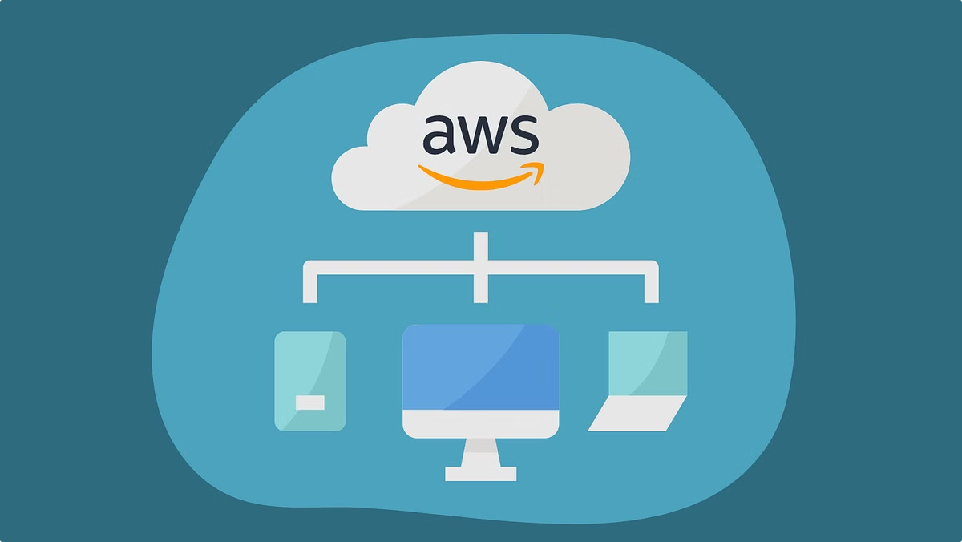
Troubleshooting, Design & Implementing Clients Windows 10 and 11 in Centralized CentOS Server Administration in AWS Cloud Infrastructure
This project focuses on troubleshooting, designing, and implementing a centralized administration solution for Windows using a CentOS server in AWS Cloud infrastructure. It covers networking, authentication, file sharing, and performance optimization, ensuring secure, efficient, and scalable management of client systems.

Slide 3


Introduction
1
AWS Cloud Infrastructure
2
EC2 Instances
Amazon Elastic Compute Cloud (EC2) enables users to launch and manage virtual machines called instances, providing a flexible and scalable computing environment.
AWS (Amazon Web Services) offers a comprehensive cloud platform with services for computing, storage, networking, databases, and more.
3
CentOS Administration
CentOS (Community Enterprise Operating System) is a stable and reliable Linux distribution often used for server deployments and infrastructure management.

Slide 4


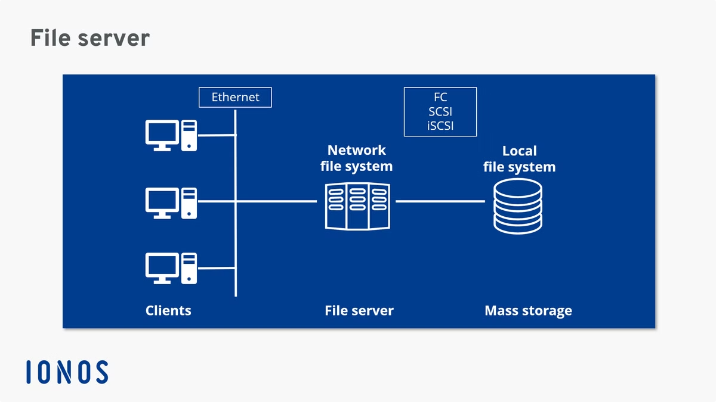


Project Objective
Integration
The project focuses on seamlessly integrating Windows with a CentOS server, enabling efficient administration and resource sharing.
Configuration
This involves setting up appropriate configurations on AWS infrastructure, including network settings, security groups, and user permissions.
Troubleshooting
Troubleshooting and resolving any issues that arise during the integration process are essential for smooth operation.

Slide 5

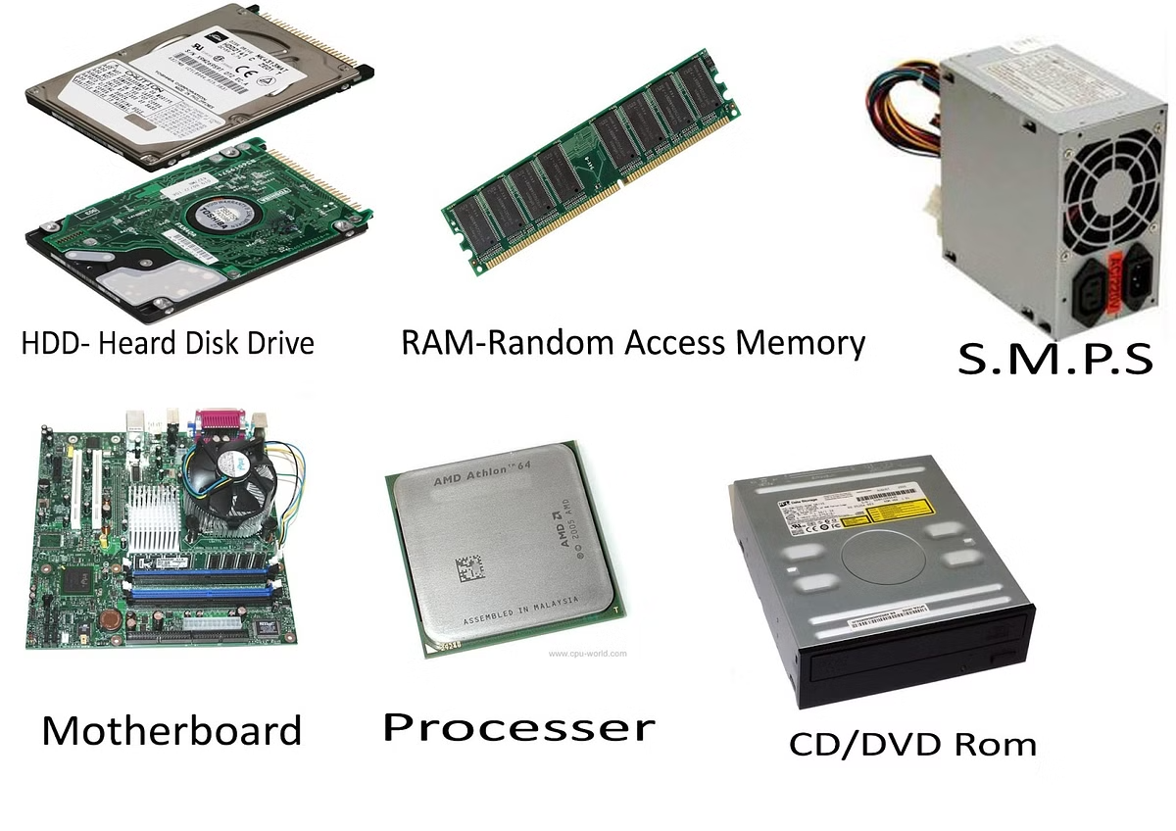
Design and Implementation Considerations
Hardware Requirements
Minimum RAM: 8 GB, Intel i5 Processor, SSD
Software Requirements
AWS EC2 Instances, Oracle VirtualBox, Samba for file sharing

Slide 6
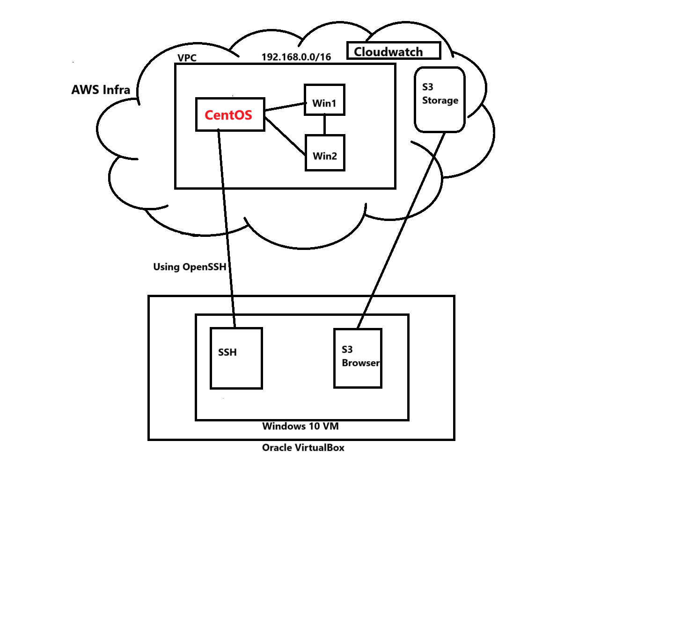

Slide 7
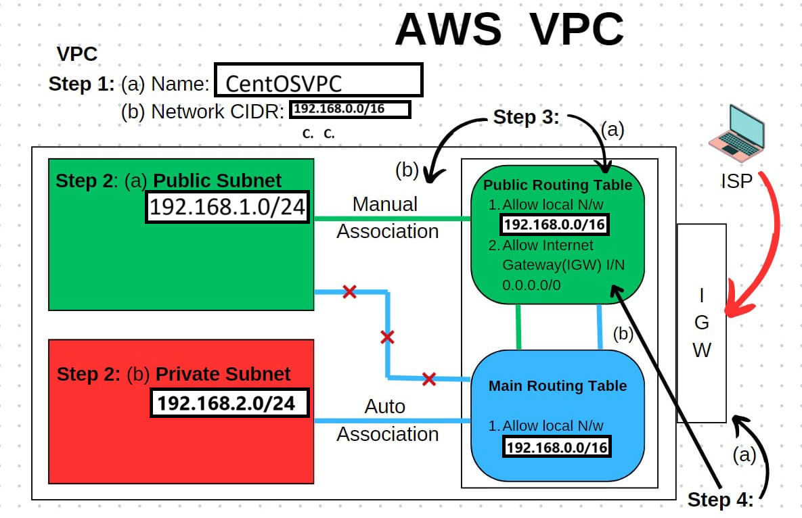

Slide 8
Network Architecture
VPC Setup
Instances
Virtual Private Cloud (VPC) provides a secure and isolated network environment within AWS, allowing for private networking and resource management.
Instances refer to virtual servers that run applications and workloads on the cloud. These instances are part of the Amazon EC2 (Elastic Compute Cloud)service, which provides scalable computing capacity in the cloud.
Security Group
A security group acts as a virtual firewall for your instance. It controls inbound and outbound traffic based on rules we define
AMI
An Amazon Machine Image (AMI) is a template with the software configuration (OS, app server, and apps) needed to launch an EC2 instance. It defines the operating system and software environment of the instance.
Key Pair
When launching an instance, AWS requires a key pair: a private key (downloaded by the user) and a public key (stored in AWS). It's used to securely connect via SSH (Linux) or RDP (Windows).

Slide 9

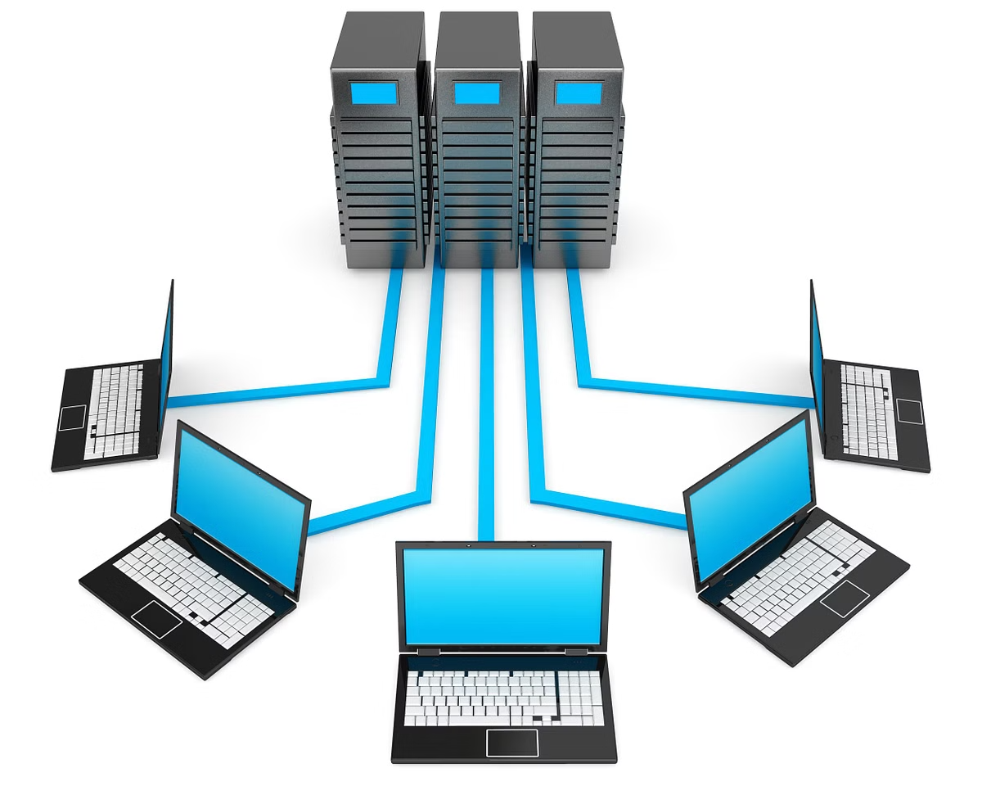
Connection Flow
1
Windows Access
Windows clients can connect to the CentOS server via remote desktop (RDP) for administrative tasks and resource access.
2
CentOS Access
Administrators can access the CentOS server using SSH (Secure Shell) for command-line management and configuration.
3
Internal Communication
Ping and file sharing capabilities are established between instances within the VPC, enabling seamless data exchange.

Slide 10
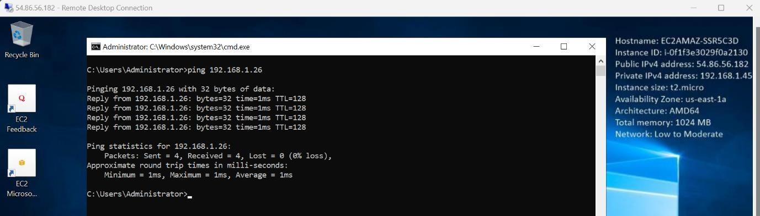
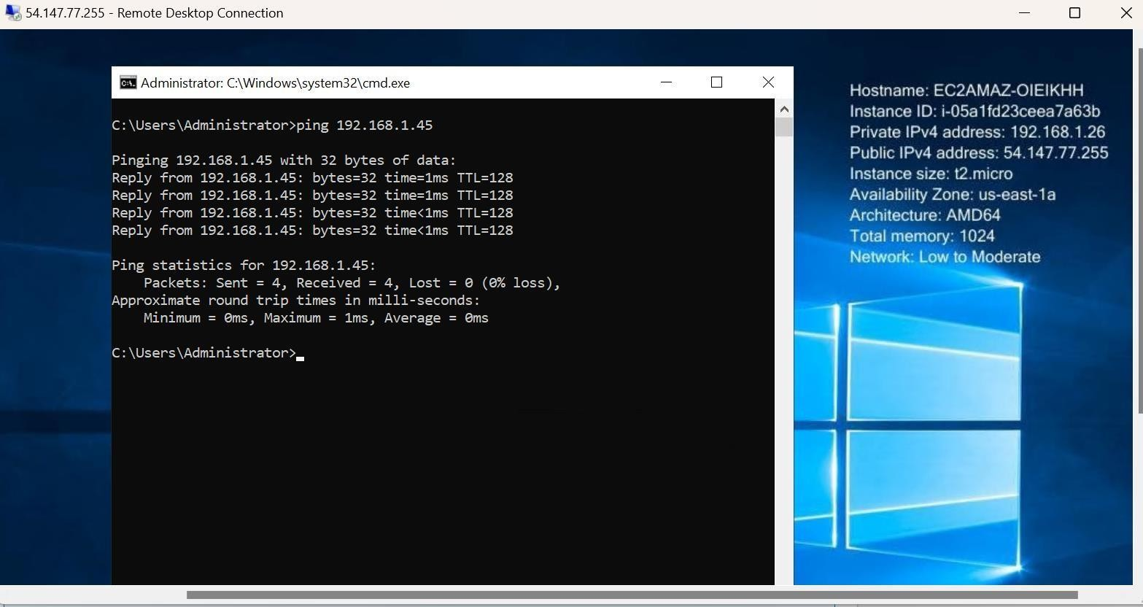
Windows1 instance
ping 192.168.1.26
Windows2 instance
ping 192.168.1.45

Slide 11
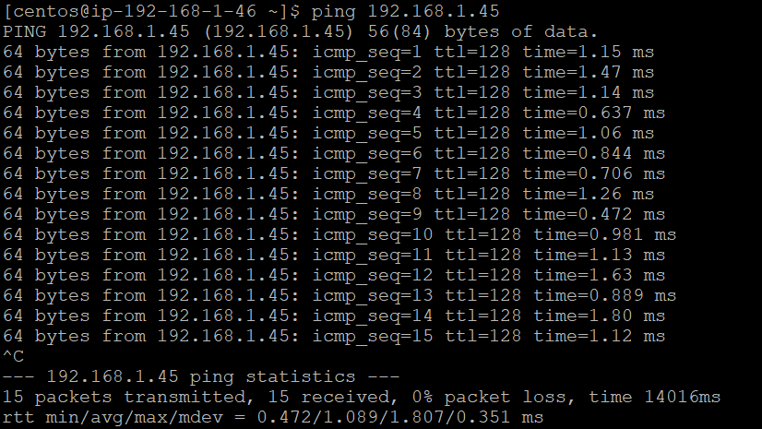
Windows1 ping in CentOS instance

Slide 12
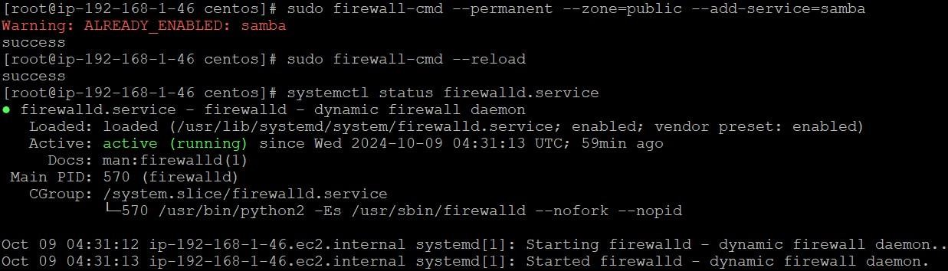
To securely connect to a remote CentOS instance (located at the public IP 54.163.68.56) using SSH
To edit the CentOS-Base.repo, inside the file:
Comment out the mirrorlist=... lines by adding # at the beginning.
Replace them with the following base URL: baseurl=http://vault.centos.org/7.9.2009/os/x86_64/
Install Samba and add service

Slide 13
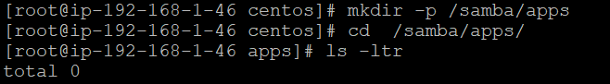
Samba File Server Implementation
The ‘/samba/apps’ folder allows centralized access for a group of users, enabling them to share and manage files securely from one location, making collaboration easier and more efficient.

Slide 14
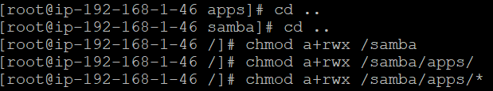
smb.conf file configuration
[global]
workgroup = SAMBA netbios name = centos
security = user
map to guest = bad user dns proxy = no
[Apps]
path = /samba/apps
browsable = yes
writable = yes
guest ok = yes
guest only = yes
read only = no

Slide 15
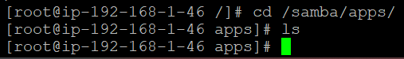
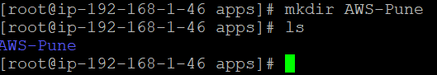
Start and enable the services Move to apps directory, initially it is empty
Create directory in CentOs Instance

Slide 16
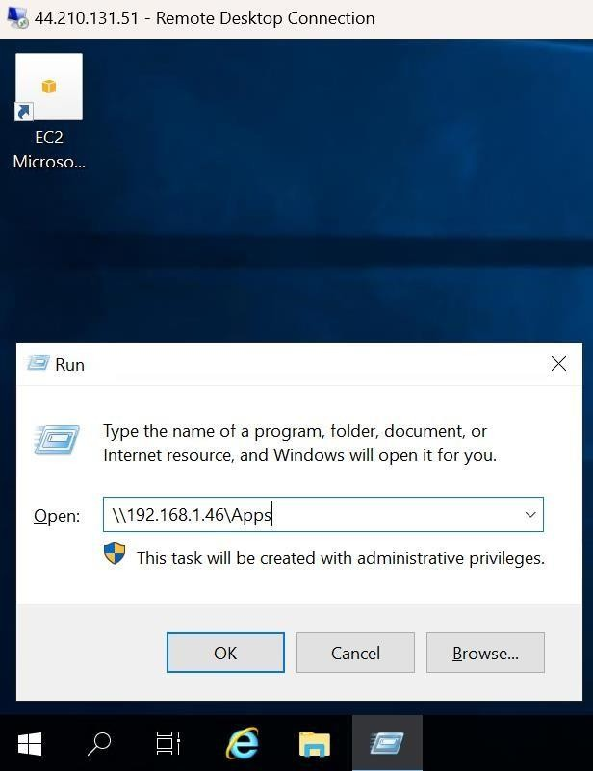
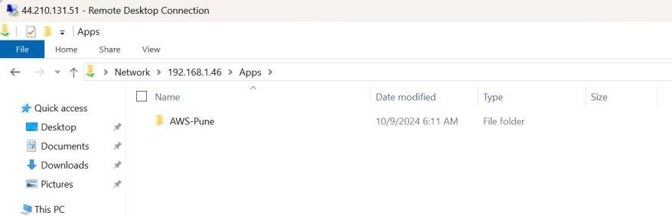
Display the directory in windows instances, which we have created in CentOS instance

Slide 17


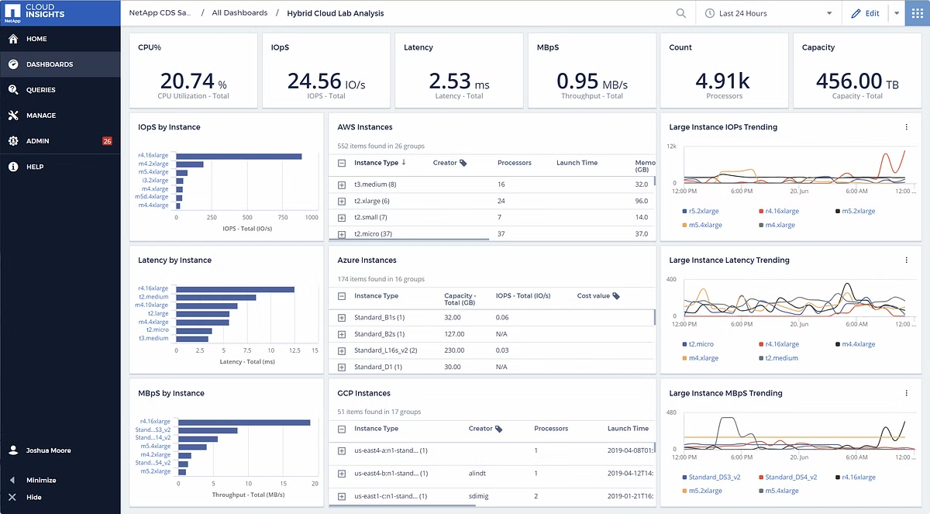


Monitoring and Management
AWS CloudWatch
CloudWatch provides comprehensive monitoring capabilities for AWS resources, allowing for real-time performance insights and proactive issue identification.
Performance Metrics
Key metrics such as CPU utilization, memory usage, and network traffic are monitored to ensure stable instance performance.
Alerts and Notifications
CloudWatch alarms can be configured to notify administrators of critical events, enabling timely interventions and minimizing downtime.

Slide 18
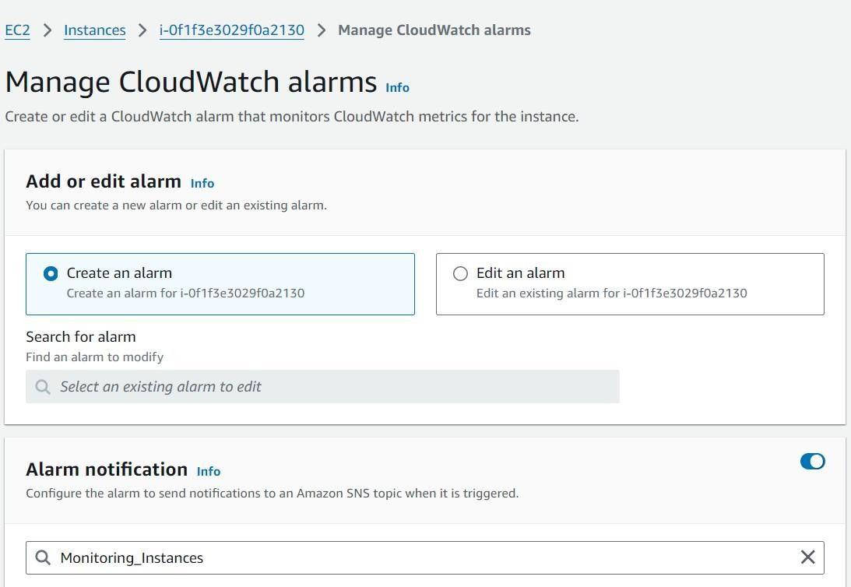
Go to SNS-> Create topic->Name the topic->Create topic
Create subscription-> Select the topic and Protocol ->Create Subscription
Now, Select the instance-> View Alarm + -> Select Create Alarm-> Select the Alarm notification(Topic which we have created)-> Select ‘Stop’ in Alarm Action-> Create.

Slide 19
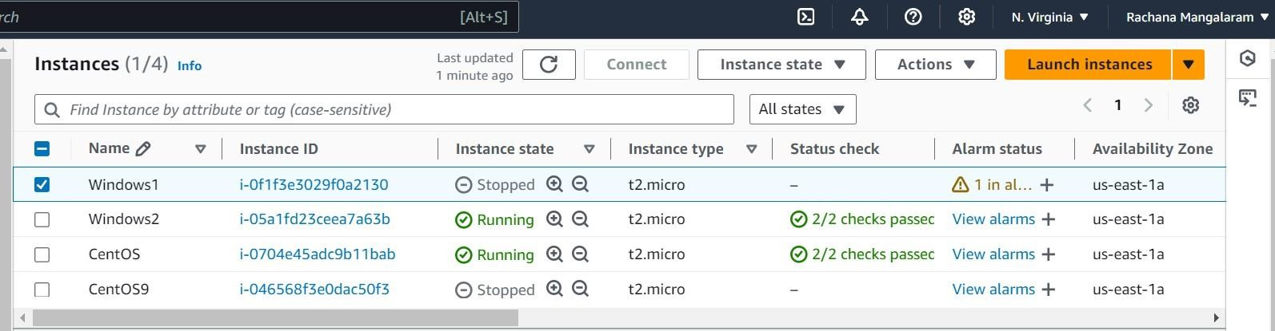
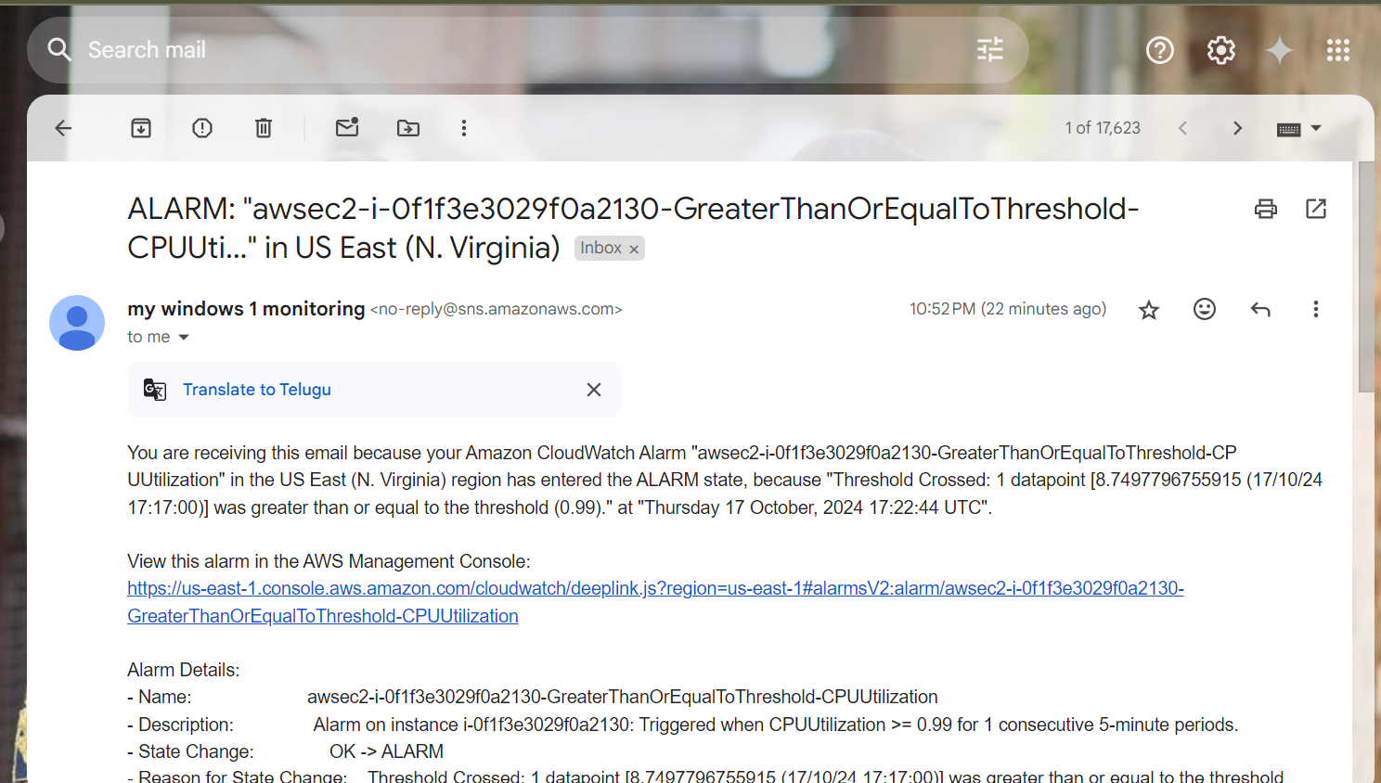
Now, Check that the Instance has stopped, as it has reached the specified value
Email has been received too

Slide 20




Troubleshooting: Connectivity Issues
A key challenge during the project was resolving EC2 connectivity issues, caused by factors like network misconfigurations and firewall rules. We systematically identified and addressed the root causes.
Network Configuration
We carefully reviewed network configuration settings, including subnet masks, IP addresses, and routing tables, ensuring they were correctly assigned and aligned.
Security Groups
Security group rules were meticulously reviewed and adjusted to ensure proper network traffic flow, allowing necessary communication between instances.
Firewall Rules
Firewall rules on both the EC2 instances and the network infrastructure were checked for any blocking
policies that might have prevented connectivity.
Network Connectivity Tests
We conducted network connectivity tests using tools like ping and traceroute to identify network
bottlenecks or communication failures.

Slide 21
Troubleshooting: IP Addressing and VPC Configuration
Incorrect IP addressing was another challenge. We encountered issues with overlapping IP addresses or improper IP address assignments, leading to network conflicts and communication problems. We also had to ensure that the virtual private cloud (VPC) was properly configured, including the presence of an internet gateway (IGW) to facilitate communication with the external internet.
IP Address Conflicts
VPC Configuration
Route Table Configuration
We carefully examined IP addresses assigned to all instances, ensuring no duplicates existed. We adjusted IP addresses as needed to avoid conflicts.
We confirmed that the VPC was properly configured, including a valid internet gateway, to enable communication with the external network.
We verified that the route tables within the VPC were correctly set up to route traffic appropriately between instances and the external network.

Slide 22



Troubleshooting: PuTTY SSH and File/Directory Issues
We also faced challenges with PuTTY, a popular SSH client, and file/directory issues on the CentOS server. Problems with PuTTY's SSH connection could stem from incorrect configurations or firewall restrictions, preventing us from accessing the CentOS server remotely. We also encountered situations where permissions on specific files or directories on the CentOS server hampered operations.
SSH Connection
File Permissions
Troubleshooting

Slide 23
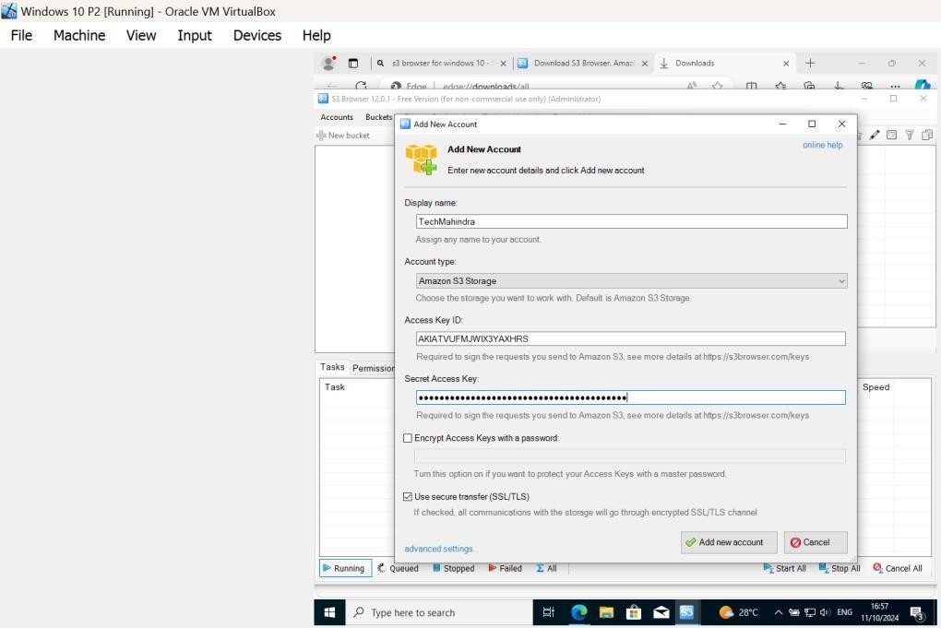
Additional tasks:
1) Use of S3 Browser in Windows 10 VM to access AWS
1) Open S3 Browse:
Launch the S3 Browser from the Windows 10 start menu.
2) Add New Account:
In the S3 Browser, click on Accounts in the top menu, then select Add New Account.
3) Enter AWS Credentials:
Input your AWS IAM Access Key ID and
Secret Access Key.

Slide 24
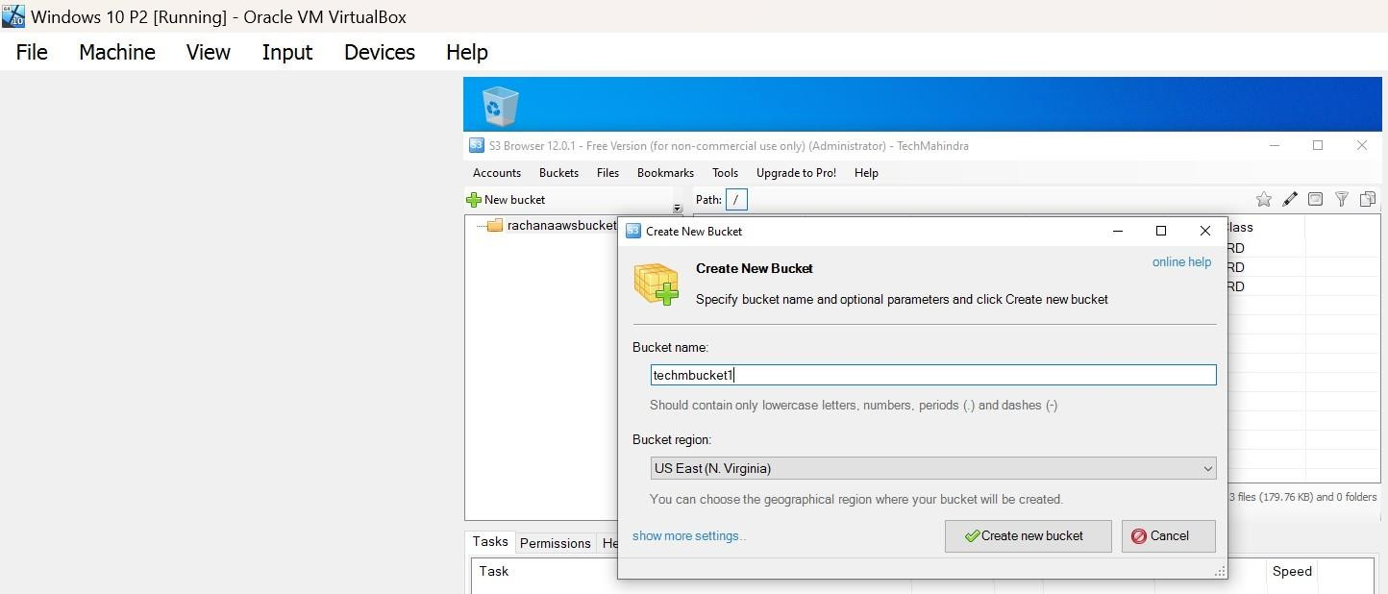
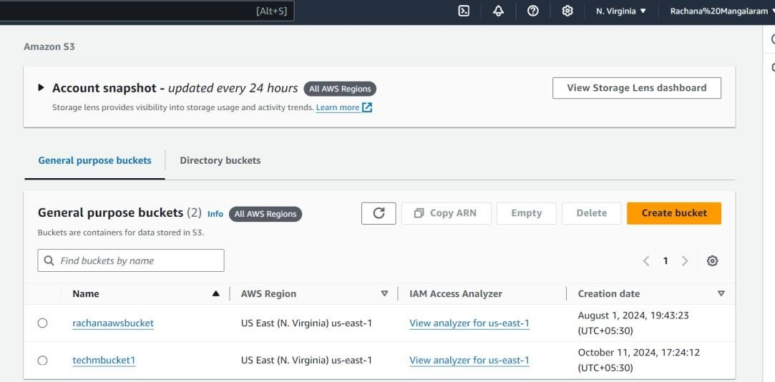
Create a new Bucket in Windows 10VM ie from S3Browser
Here, ‘techmbucket1’ is the of bucket created
It is reflected in AWS too

Slide 25
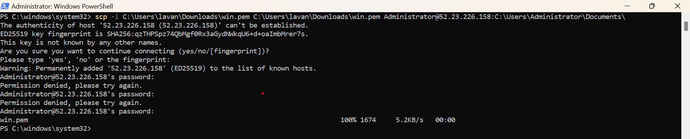
2) Using OpenSSH Server for accessing the instances from Windows 10 VM( Oracle VirtualBox)
To Access Windows EC2 instances in Windows 10 VM(from Oracle Virtual Box)
Go to host machine’s Powershell(Run as administrator) and execute the following command
scp -i C:\Users\lavan\Downloads\win.pem C:\Users\lavan\Downloads\win.pem Administrator@52.23.226.158:C:\Users\Administrator\Documents\
After executing the above command, we will be getting the win.pem file from host machine to Windows EC2 instance when connected
via RDP

Slide 26
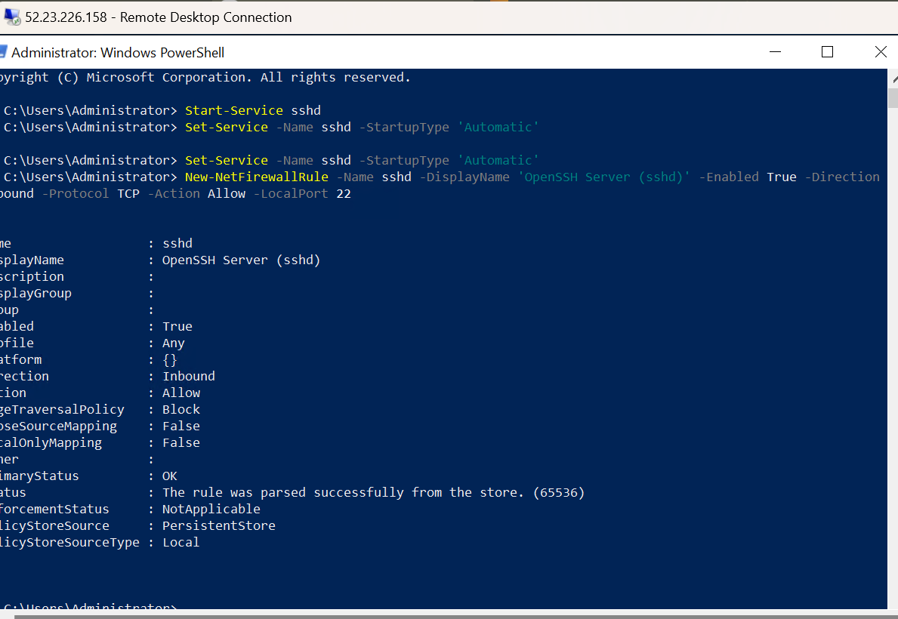
In windows instance(connected via RDP), add/install the feature of OpenSSH Server from the Manage Optional features
Go to Powershell(Run as administrator) and perform the below commands

Slide 27
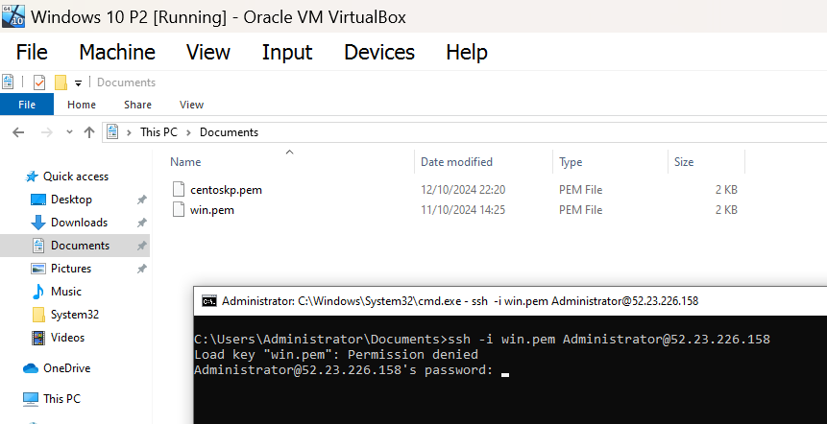
Move to the Windows 10 VM (from Oracle VirtualBox)
Get the .pem file and paste it in Documents directroy
Install OpenSSH Server from Manage Optional features in settings

Slide 28
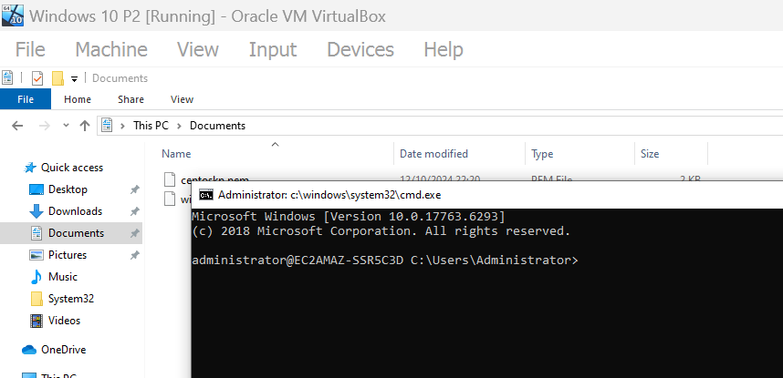
After pasting the password(generated from .pem file), will be getting the below interface
(Same can be done for Windows2 EC2 instance )
Same steps applied for accessing CentOS instance too

Slide 29
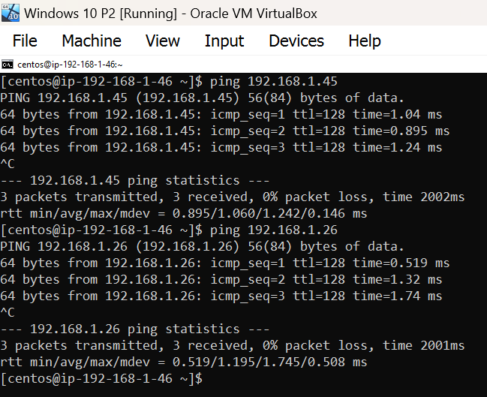
It can even ping the Windows EC2 instances(Windows1 and Windows2) from Windows 10 VM

Slide 30


Conclusion
1
Key Takeaways
2
Robust Network
3
Additional Tasks
The project successfully demonstrated the feasibility of integrating Windows with a centralized CentOS server management in an AWS cloud environment.
A robust network architecture was established, ensuring reliable communication between instances and secure access for administrators.
Used S3Browser on Windows 10 VM to access it with the access and secret keys, and accessed instances on the Windows 10 VM through OpenSSH software.

